Slide 1
InFRMed Flood Decisions
Flood Inundation Mapping Using the Flood Decision Support Toolbox
Sam Wallace
Louisiana Emergency Management Conference
May 8, 2024

Slide 2
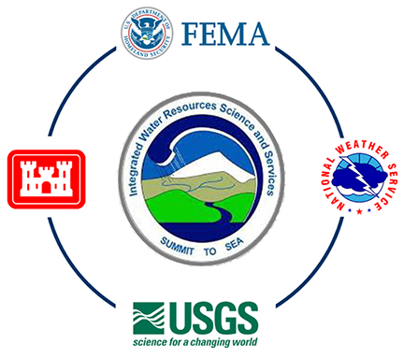
InFRM
Interagency Flood Risk Management (InFRM) Team
FEMA Region 6 – Sponsor
U.S. Army Corps of Engineers (USACE)
National Weather Service (NWS)
U.S. Geological Survey (USGS)

Slide 3




Why InFRM?
Goals
  Integrate information from different agencies and simplify access to data
  Increase accuracy and timeliness of information
  Provide high resolution information and forecasts
  Help protect life and property
  Enrich stakeholder participation
Mitigate and “InFRM” flood risk as a team
Collaborating Nationally, Empowering Locally

Slide 4
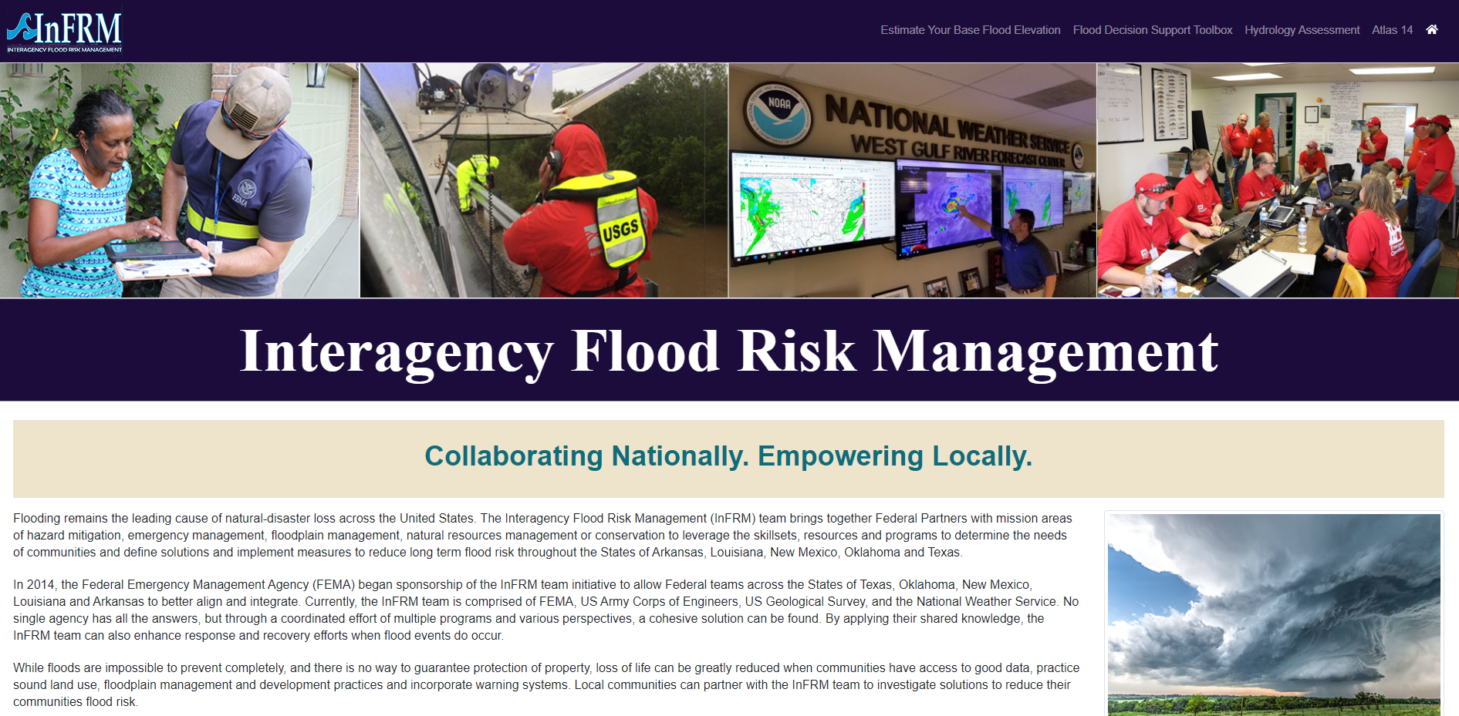
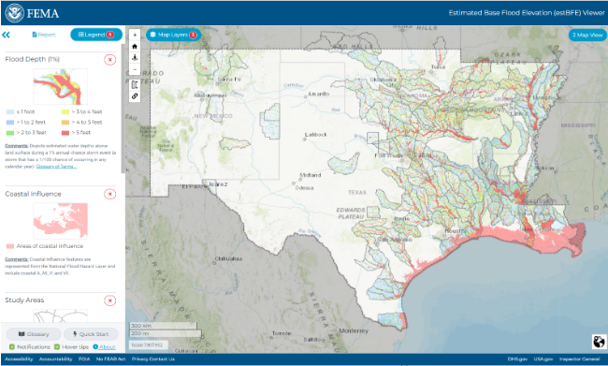
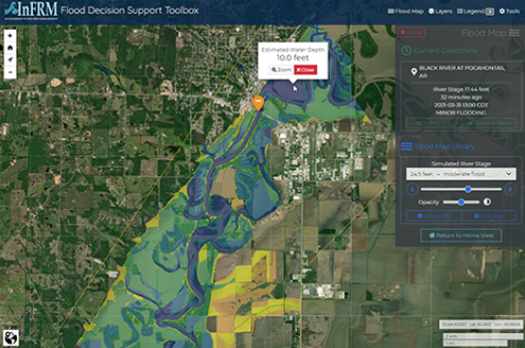

A Web Presence for InFRM https://webapps.usgs.gov/infrm/
www.InFRM.us
Estimate your base flood elevation (estBFE)
Flood Decision Support Toolbox (FDST)
Watershed Hydrology Assessments
Viewer (WHAV)

Slide 5
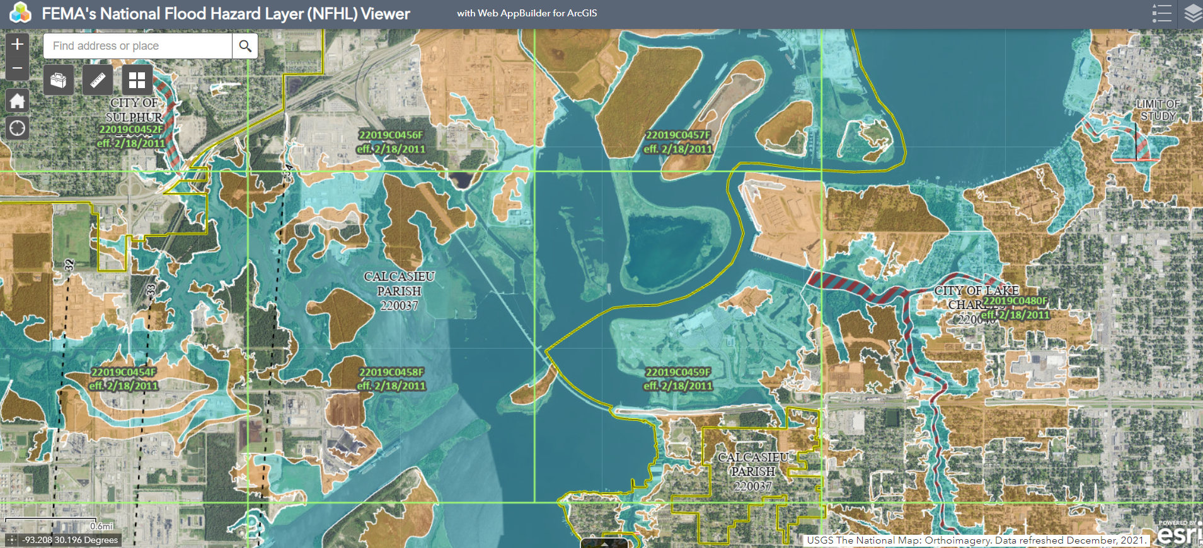
How does this map inform a flooding event?
FEMA National Flood Hazard Layer

Slide 6
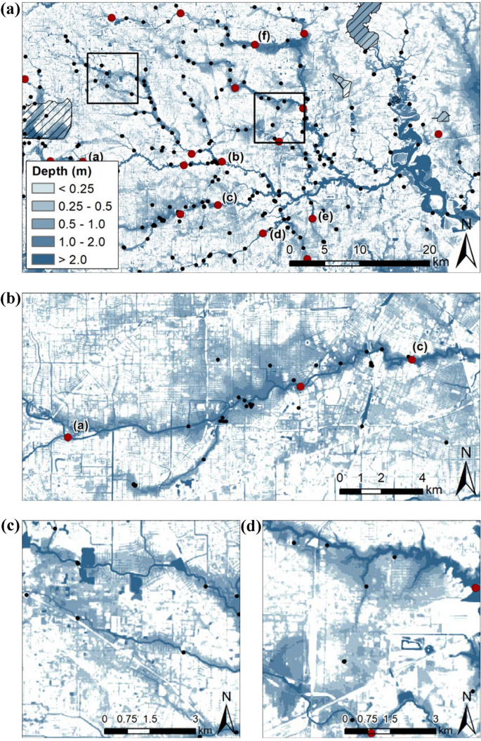
How do these maps inform a flooding event?
Sebastian, A., Bader, D.J., Nederhoff, C.M. et al. Hindcast of pluvial,
fluvial, and coastal flood damage in Houston, Texas during
Hurricane Harvey (2017) using SFINCS. Nat Hazards 109, 2343–2362
(2021). https://doi.org/10.1007/s11069-021-04922-3

Slide 7
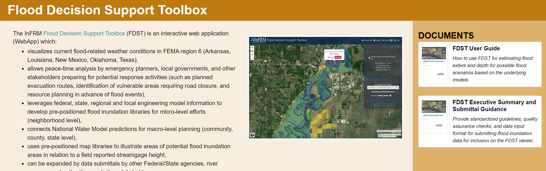
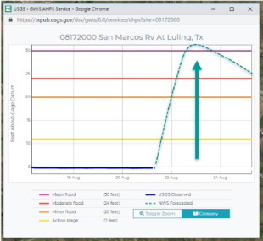
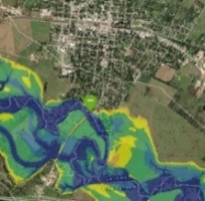
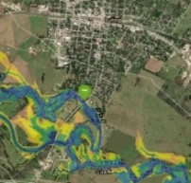
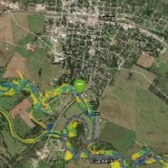
The Flood Decision Support Toolbox (FDST)
  Pre-positioned map libraries
    USGS streamgage data
    NWS River Forecasts
    NWS Flood Categories
  Scenario Planning
  Historical Flood viewing
  Print Map Generation
Notes:
Main topic of this presentation, the FDST is a web application that allows emergency planners and decision makers to make peace-time decisions about resource allocation, emergency equipment staging, evacuation decisions, etc.

Slide 8
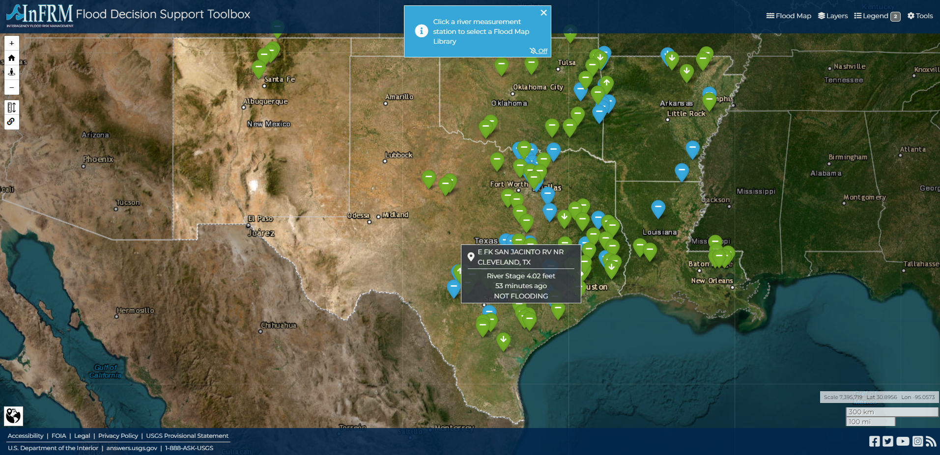


FDST Scenarios
https://webapps.usgs.gov/infrm/fdst/

Slide 9
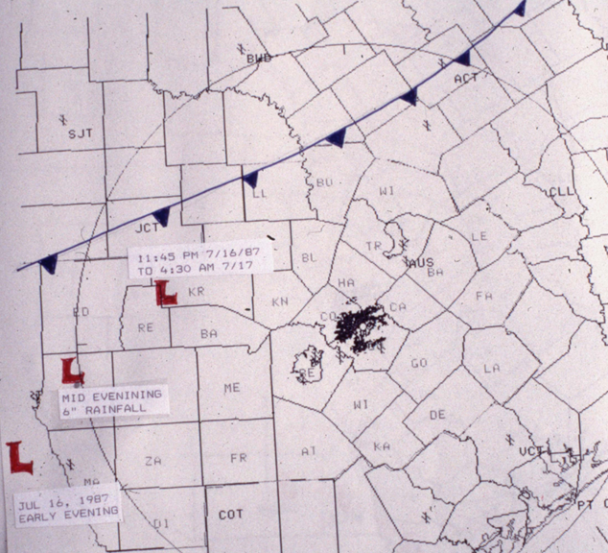
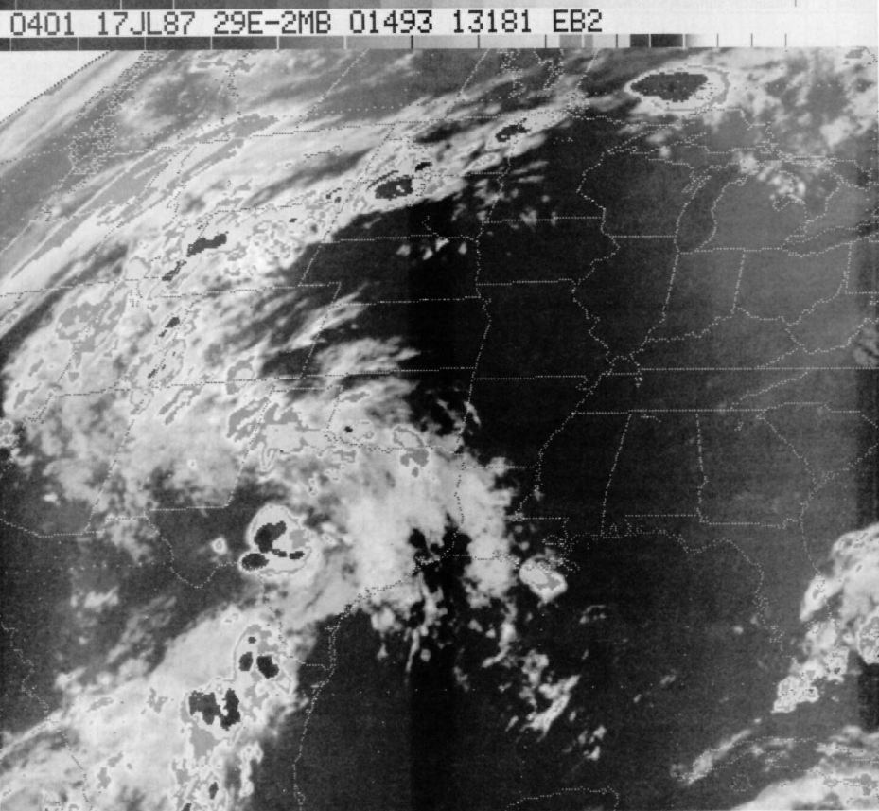
Scenario 1:
Revisiting the 1987 Guadalupe River Flood
Cold front and mid-level low on the night of July 16th
Satellite infrared image taken at 11pm CDT July 16th showing storms over the hill country

Slide 10
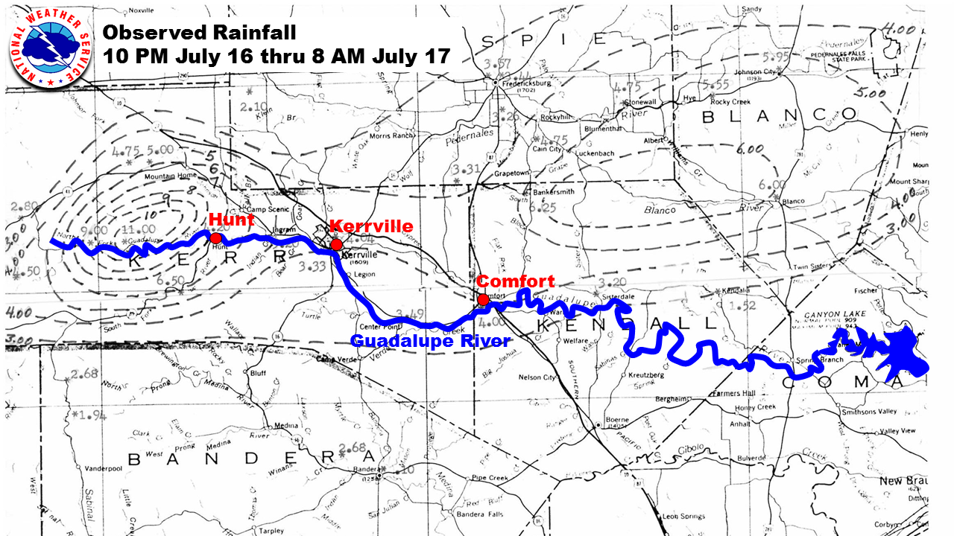
Scenario 1:
Revisiting the 1987 Guadalupe River Flood
Over 11 inches of rainfall fell on the headwaters of the Guadalupe River

Slide 11
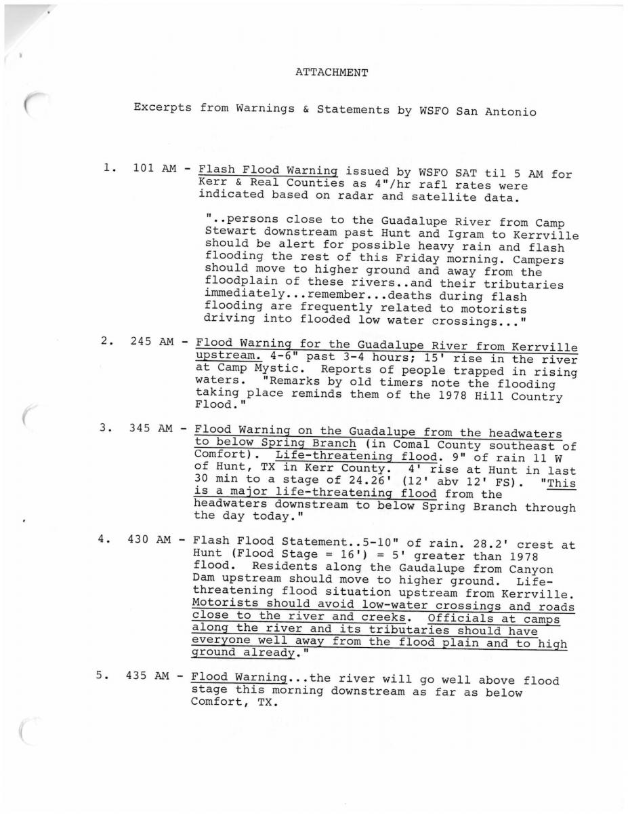
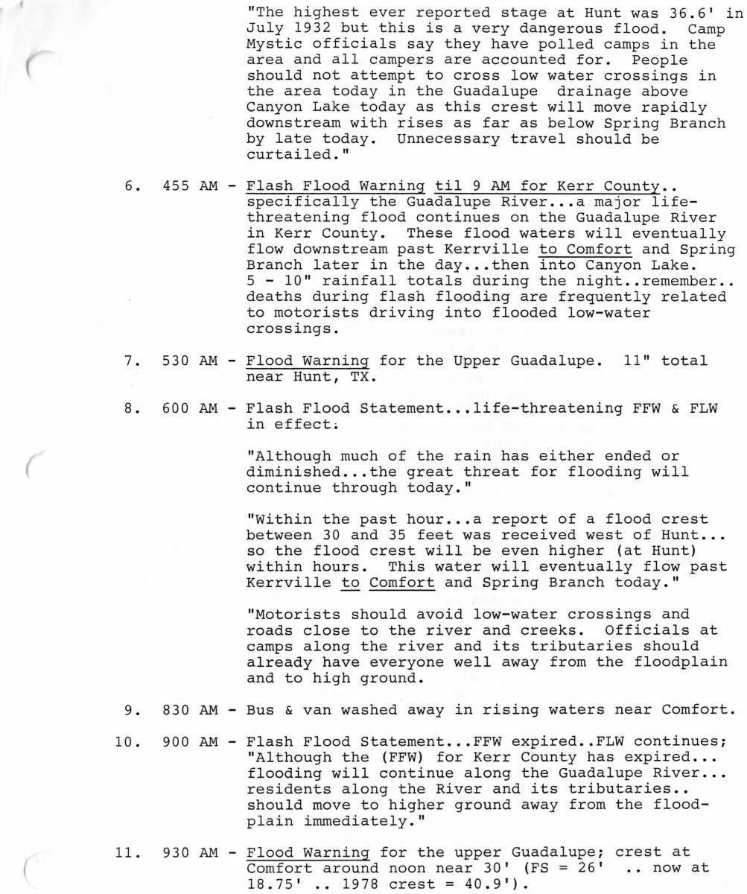
Scenario 1:
Revisiting the 1987 Guadalupe River Flood
Texts and descriptive warnings from the National Weather Service described flood potential

Slide 12
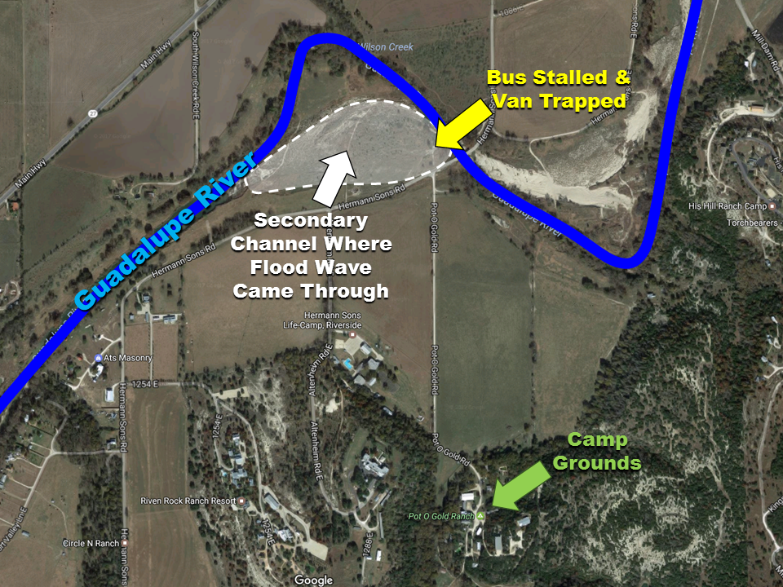
Scenario 1:
Revisiting the 1987 Guadalupe River Flood
Despite warnings, children were evacuated from camp in an attempt to beat the floodwaters to avoid being stranded.

Slide 13
Scenario 1:
Revisiting the 1987 Guadalupe River Flood
Questions in hindsight:
Why was the decision to evacuate made despite the warnings against doing so?
How could flood inundation maps be used to better inform the situation?

Slide 14

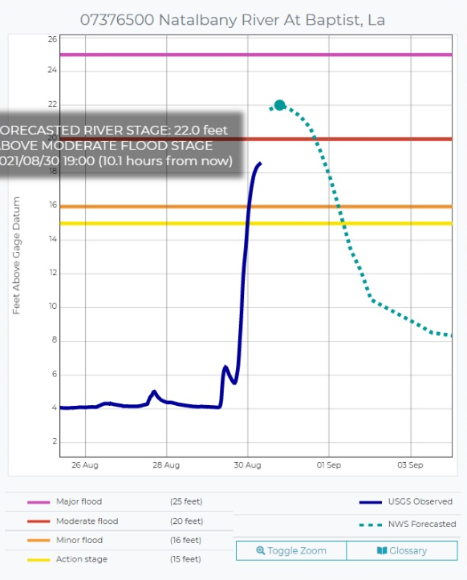

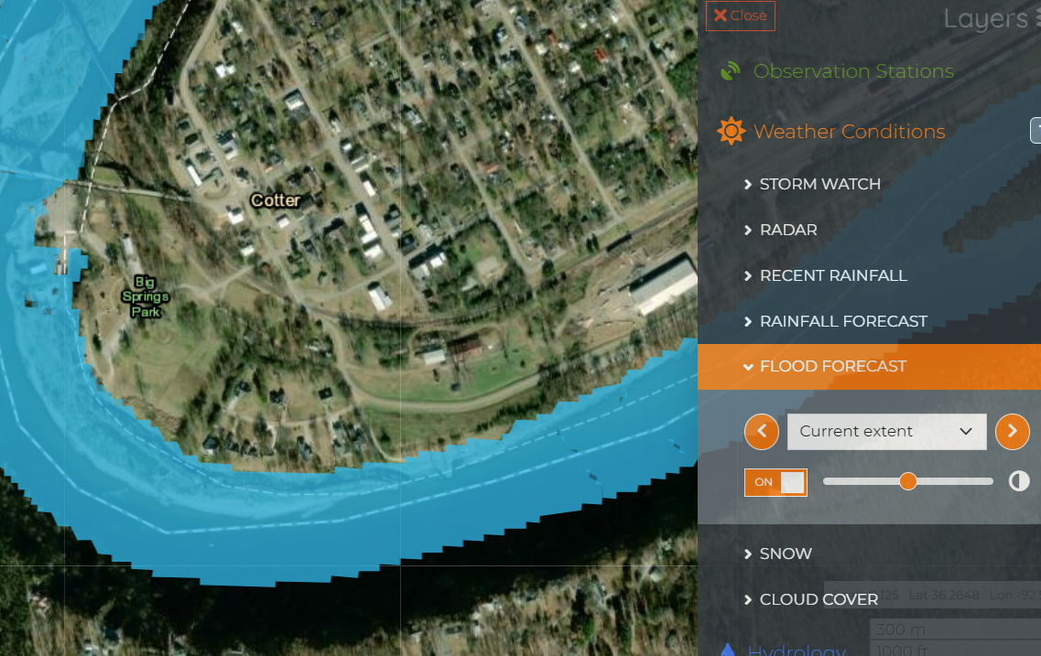
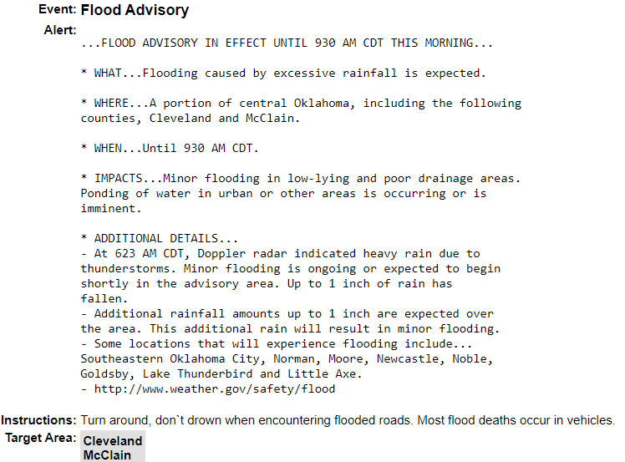
Scenario 1:
Revisiting the 1987 Guadalupe River Flood
Stage Forecasts
NATIONAL WATER MODEL
FORECAST
Forecasted Max Flood Extents
Warnings and Statements

Slide 15
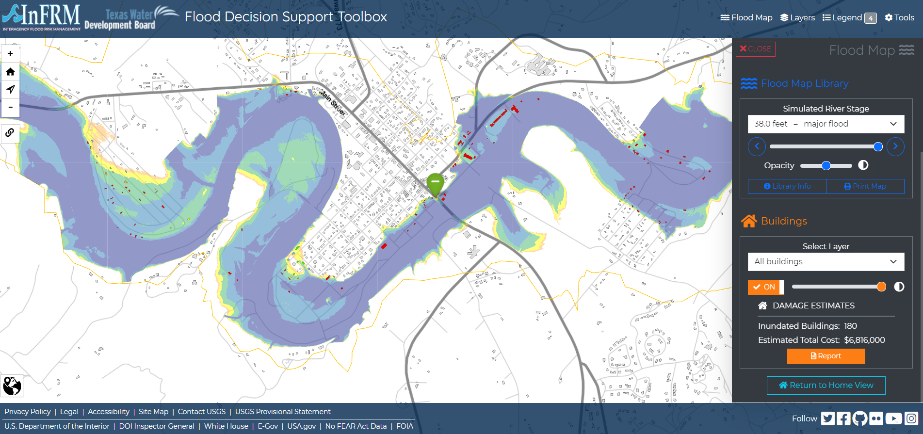
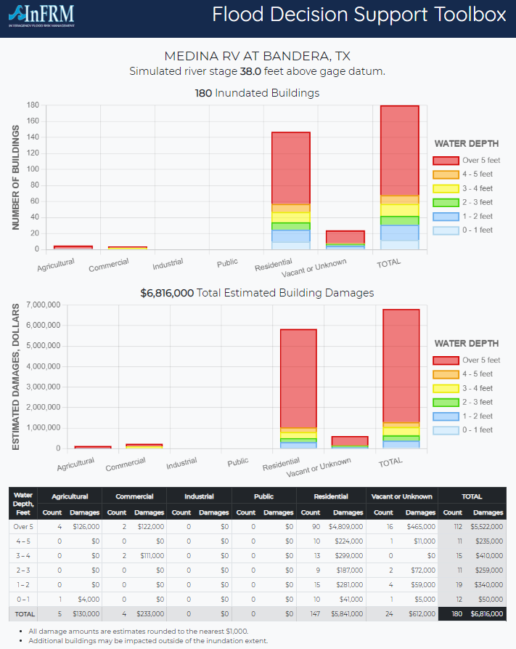
Scenario 1:
Revisiting the 1987 Guadalupe River Flood
Stage forecasts inform flood map selection
Inundation depths and extents shown along with building damages

Slide 16
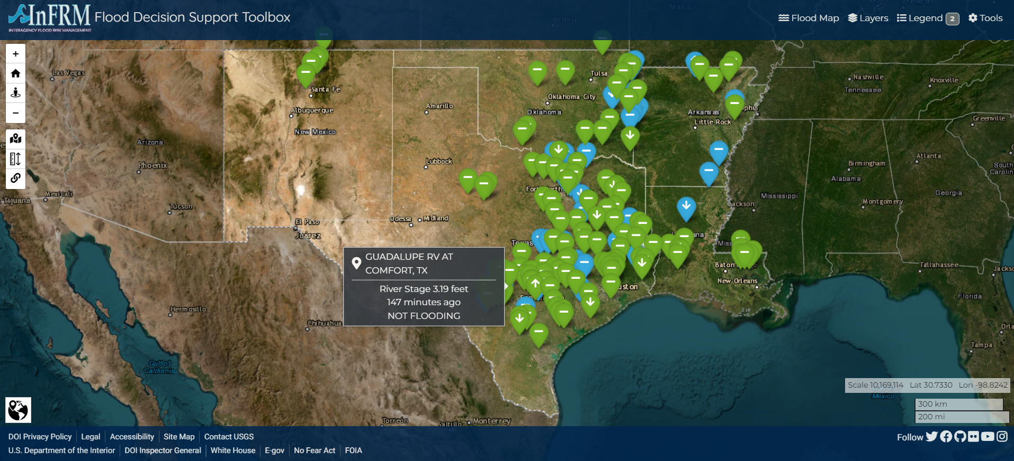
Scenario 1:
Revisiting the 1987 Guadalupe River Flood

Slide 17
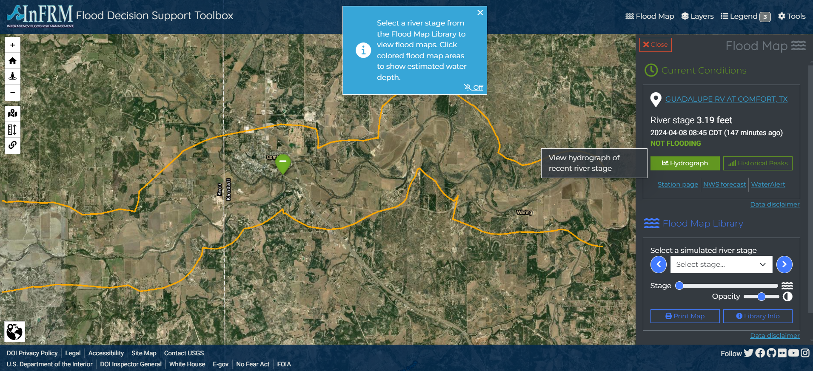
Scenario 1:
Revisiting the 1987 Guadalupe River Flood

Slide 18
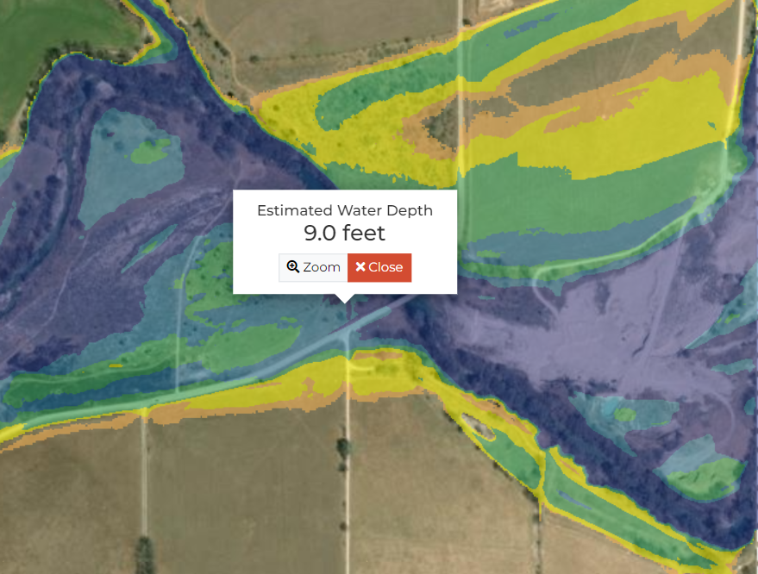
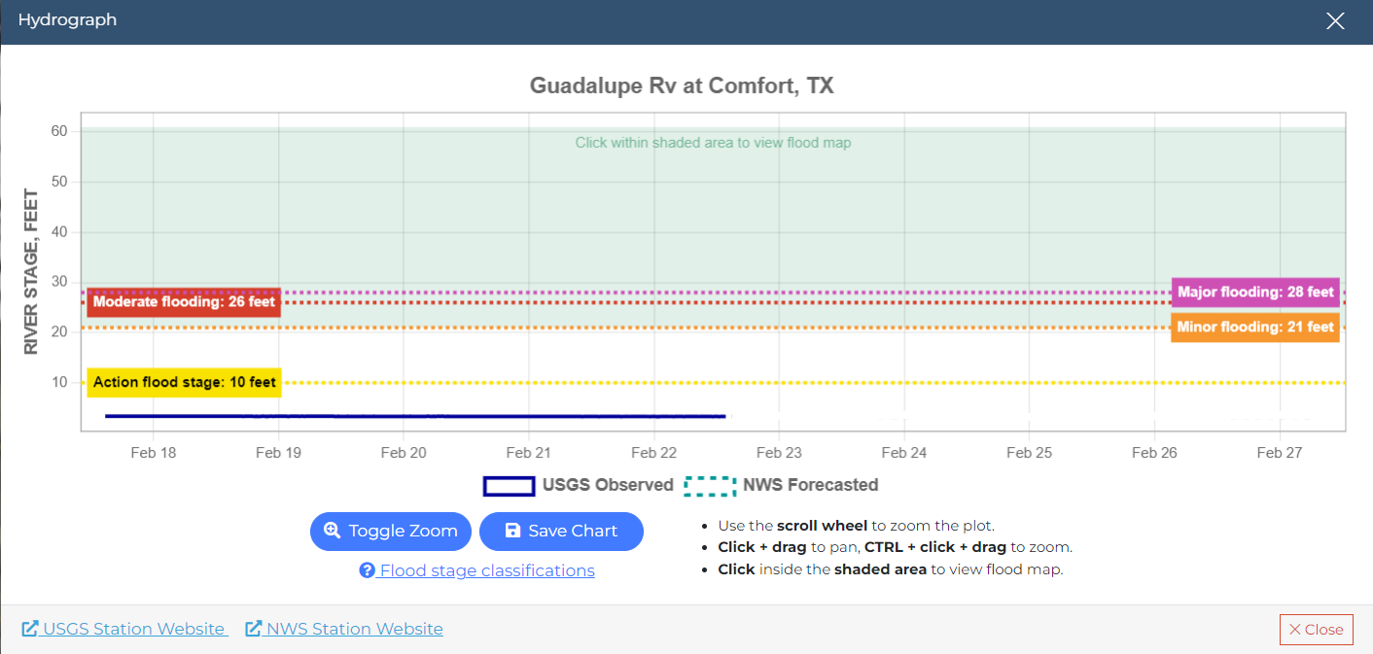
Scenario 1:
Revisiting the 1987 Guadalupe River Flood
FDST quickly shows the extent and depth of floodwaters associated with the maximum forecasted stage at the Comfort gage.
Major flooding at 31.5 feet

Slide 19
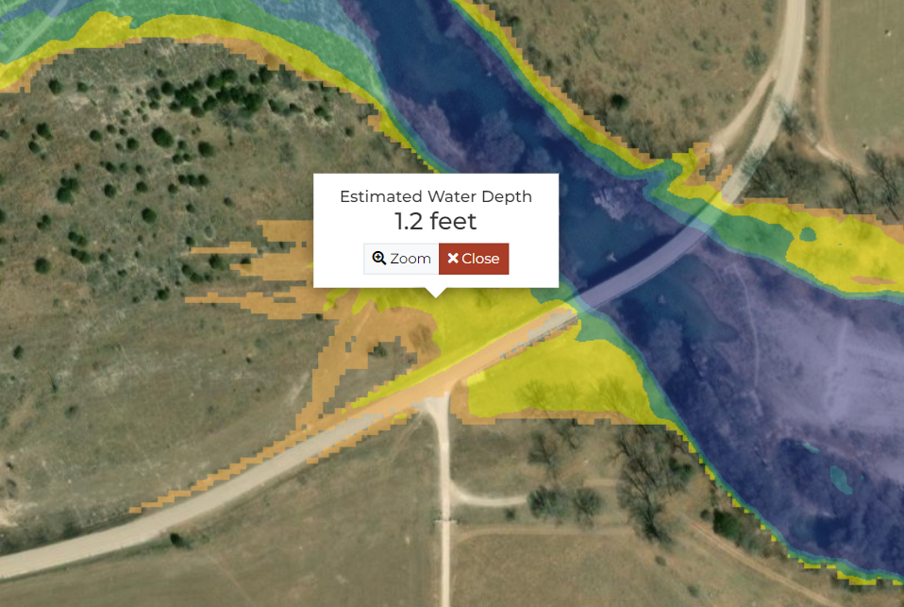
Scenario 1:
Revisiting the 1987 Guadalupe River Flood
FDST shows not just the peak of the floodwaters, but each half foot interval in the rising and falling flood.
Road appears flooded at 22 feet

Slide 20
Scenario 2:
Preparing for another Hurricane Harvey
Questions:
How widespread would floodwaters be in the event of a storm similar in magnitude to Hurricane Harvey?
Which buildings might be damaged by floodwaters, and at what financial cost to the community?
Who will need to be evacuated, and what infrastructure could be affected by floodwaters?

Slide 21
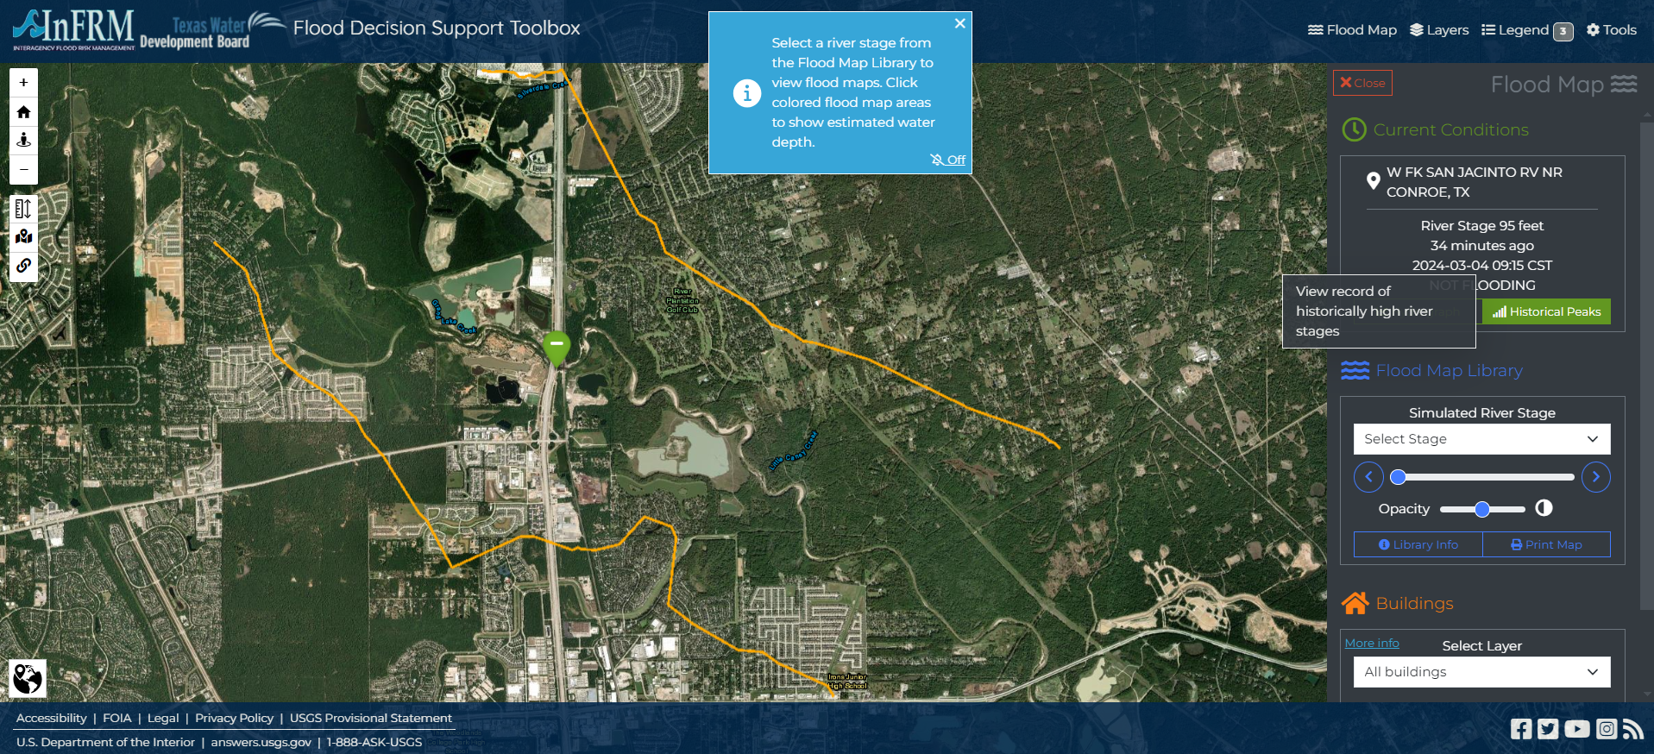
Scenario 2:
Preparing for another Hurricane Harvey
Example: West Fork San Jacinto River near Conroe, Tex.
Historical peaks lists the stages of the 10 highest peaks and displays the flood map closest to each stage.

Slide 22
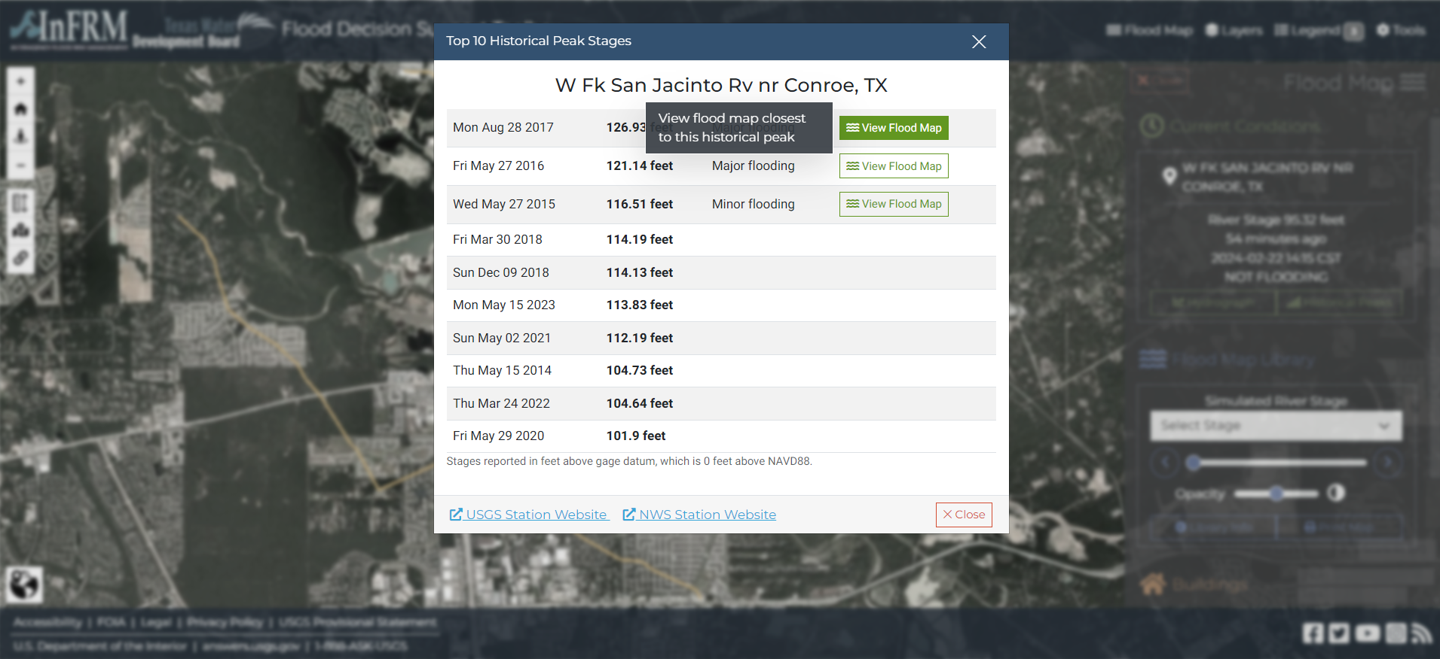
Scenario 2:
Preparing for another Hurricane Harvey
Example: West Fork San Jacinto River near Conroe, Tex.
Historical peaks lists the stages of the 10 highest peaks and displays the flood map closest to each stage.

Slide 23
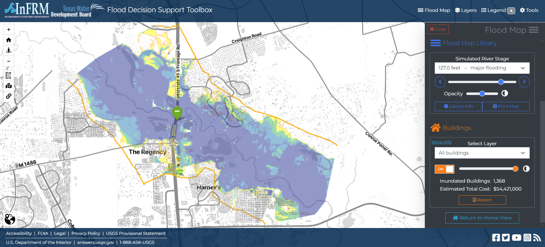
Scenario 2:
Preparing for another Hurricane Harvey
With buildings layer on (Texas-only) we see widespread damage, with an estimated 1,368 buildings impacted at an estimated total cost of over $54 million.

Slide 24
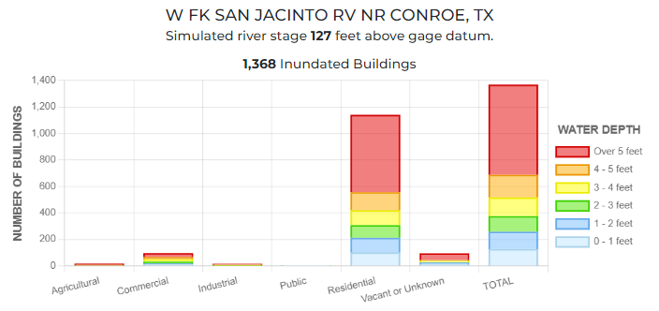
Scenario 2:
Preparing for another Hurricane Harvey
The damages report shows that the majority of structures inundated are residential. This suggests 1) a need to evacuate a large number of people and 2) a potential need for long-term shelters for a large population.

Slide 25
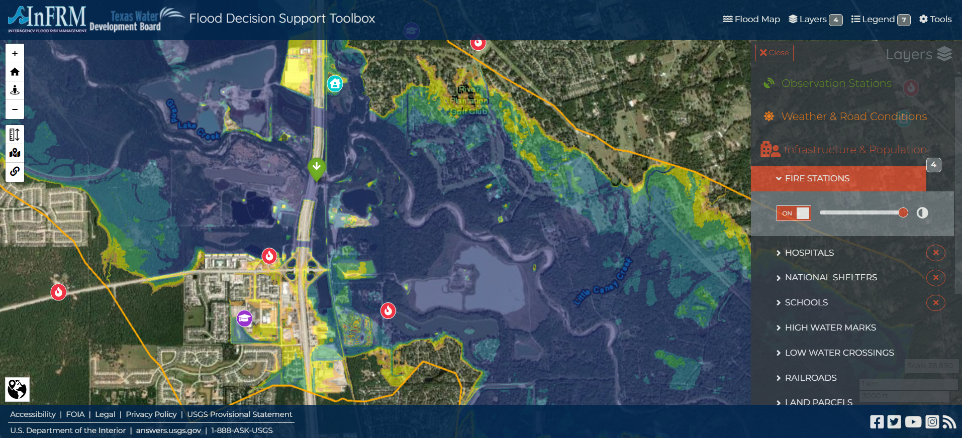
Scenario 2:
Preparing for another Hurricane Harvey
Two fire stations and a school could be impacted by floodwaters at this stage.

Slide 26
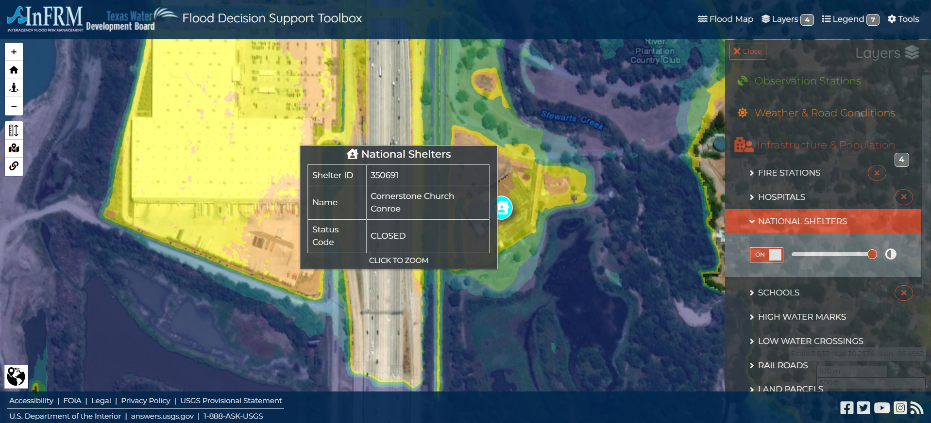
Scenario 2:
Preparing for another Hurricane Harvey
One national shelter appears to be flooded and surrounded by floodwaters, necessitating the plan for another shelter for the large number of residents flooded.

Slide 27
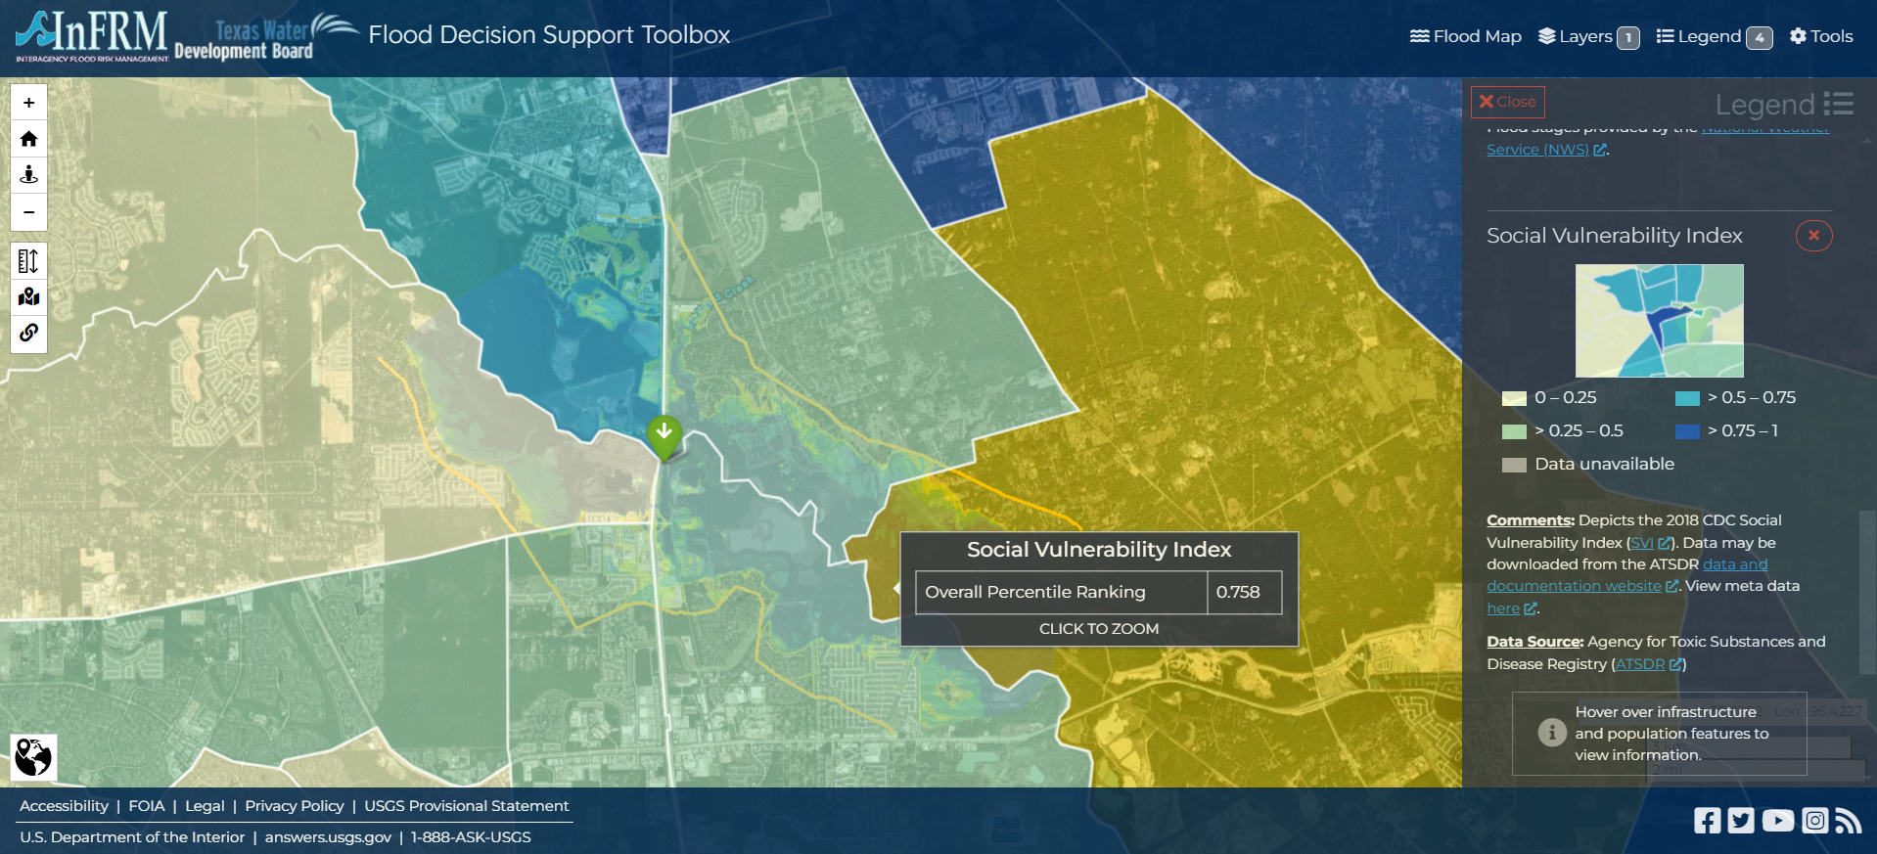
Scenario 2:
Preparing for another Hurricane Harvey
FDST also shows social vulnerability index (SVI) by census tract. This tool can help identify areas within communities where flooding may have a disproportionate impact on the population. Do the residents need additional evacuation time due to age?
Will recovery take longer because of financial need?

Slide 28
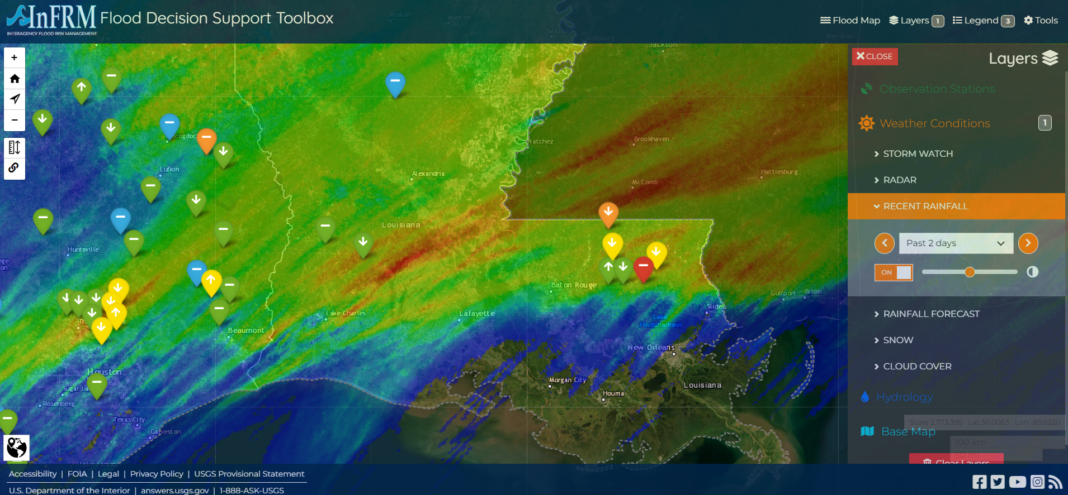
FDST Functionality

Slide 29
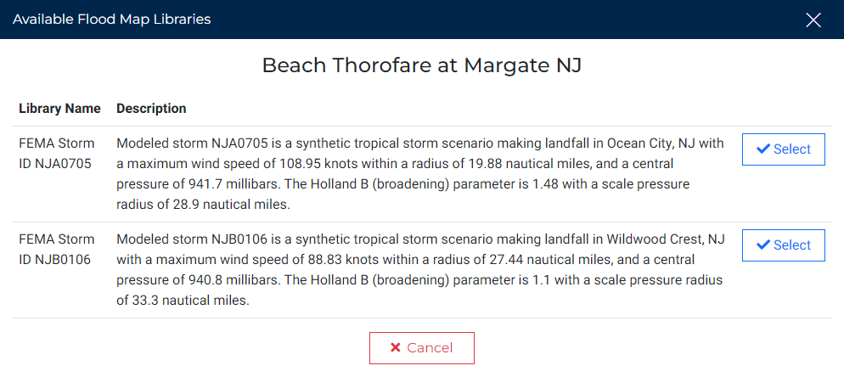
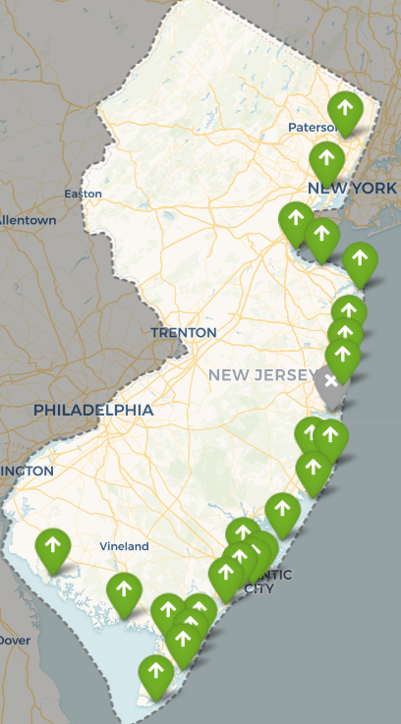
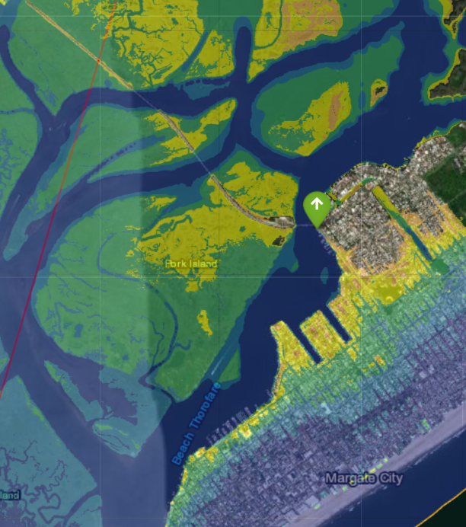
FDST Functionality – New Jersey
New Jersey uses tropical storm/hurricane modeling to map storm surge at Estuary (Coastal) Gages
Two storm track scenarios and simulated stages for each

Slide 30
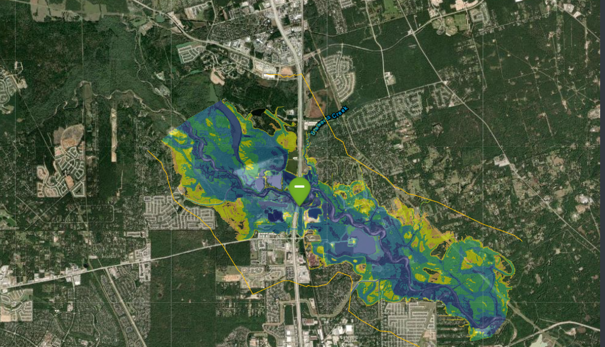
Uncertainty in Modeling
“All models are wrong but some are useful.”
—George Edward Pelham Box
Model Uncertainty
  Tier A/B
  Rating Curve RMSE
  Uncertainty in forecasts
FDST maps only the flow measured at gage
  (overland, tributary flow not accounted for)
Highest
uncertainty
Tributary Inflow
Most confidence at gage location
Highest uncertainty

Slide 31
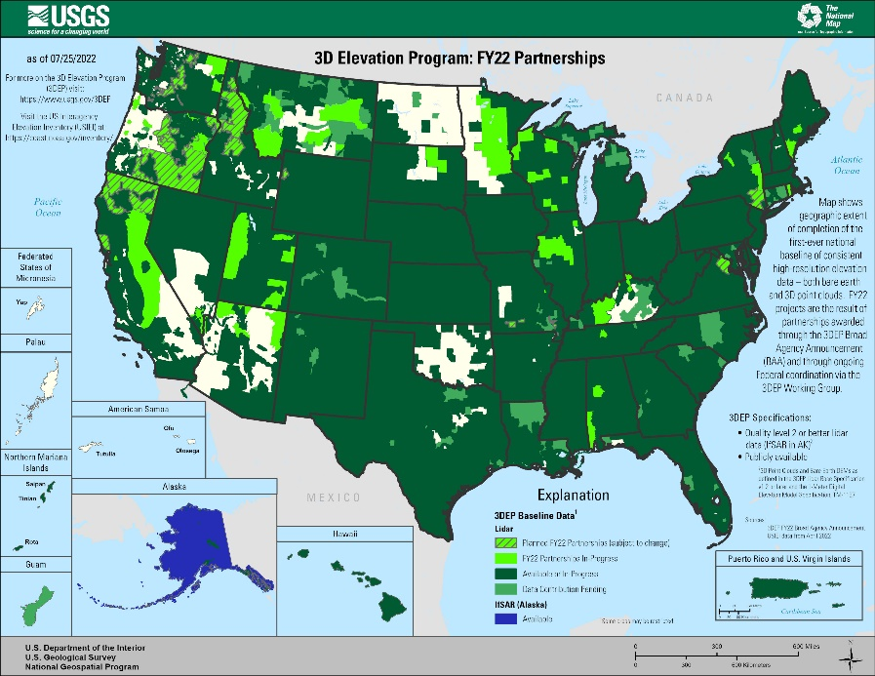
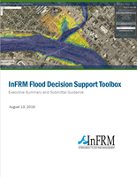
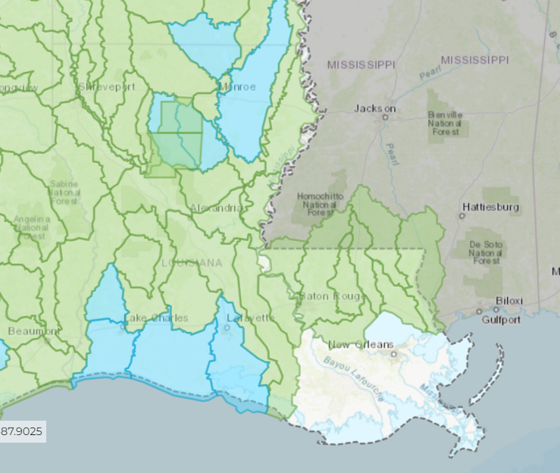
Collaborating Nationally, Empowering Locally
Collaborating Nationally:
  USGS streamgaging network
  FEMA funded BLE models
  NWS river forecasts
  InFRM federal guidance and technical support
Empowering Locally:
  FDST free to use, free to upload
  Local feedback for functionality
  Locally-led map library development

Slide 32

Sam Wallace
Hydrologist
Oklahoma-Texas Water Science Center
dswallace@usgs.gov
682-319-6918
InFRM.us
webapps.usgs.gov/infrm/fdst/

